Slide 1
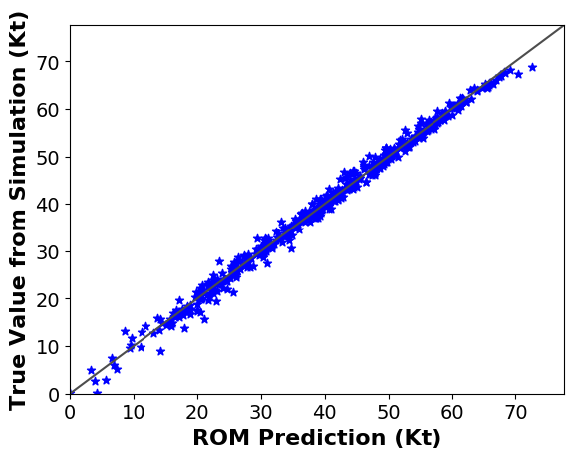
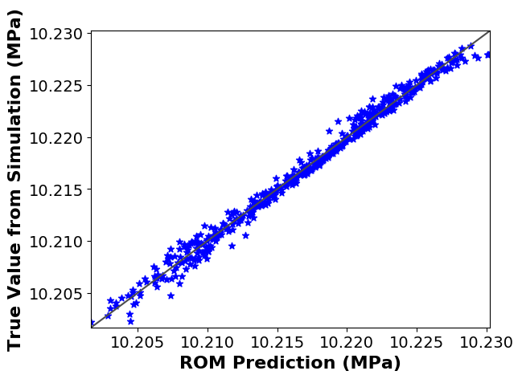


$$R=0.996$$
$$R=0.995$$

Slide 2
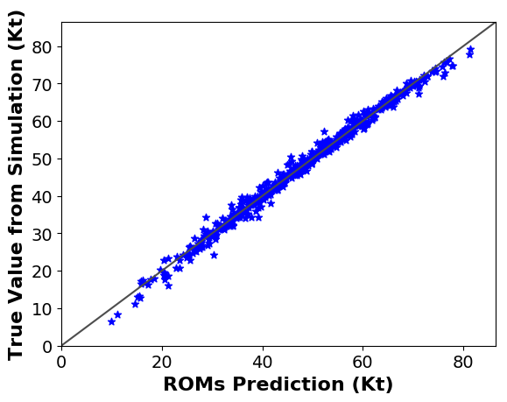
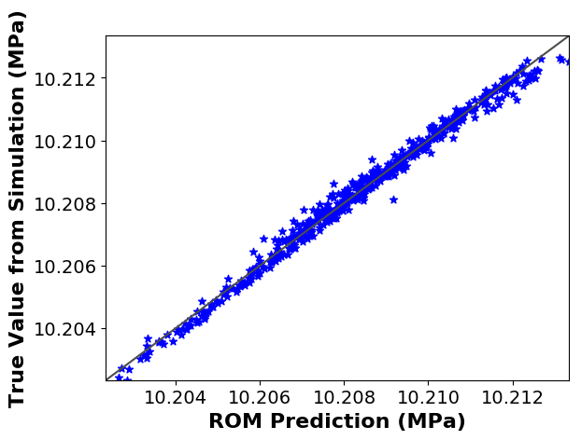


$$R=0.995$$
$$R=0.994$$

Slide 4
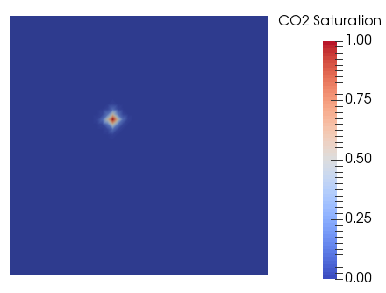
L3
1000 m
Injector
L1
L2
1000 m

